Slide 1
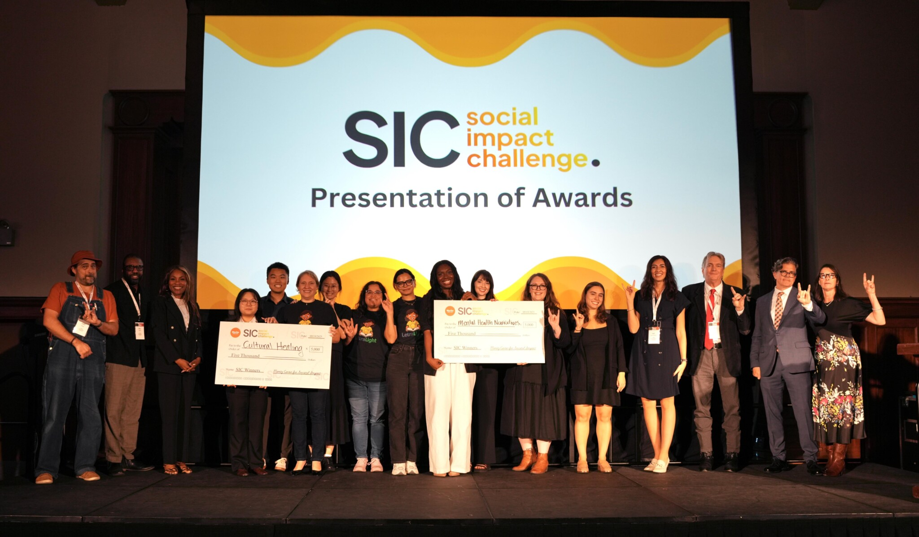


Using the arts & humanities to
improve behavioral health

Slide 2

HOW CAN ARTS & HUMANITIES ADDRESS BEHAVIORIAL HEALTH?
Creative Arts Therapy: Art, music, drama, dance, etc., as therapeutic tools.
2025 Examples:
Teaching a literature course on mental health experiences for incarcerated UT students at Texas Prison Education Initiative.
Community-research-arts partnership using culturally grounded arts-based strategies to support behavioral health in Asian-American communities.
Teaching cooking as an accessible art of creative expression to food insecure UT students.
Providing culturally responsive teaching through folklore, arts, traditional songs, and language for improved Portuguese literacy and improved outcomes in English.
Narrative and Storytelling:
Personal stories or fiction to foster understanding and reduce stigma.
Digital Arts:
Online or digital interventions, like virtual exhibitions or social media campaigns for mental health awareness.
Educational Projects: Increase mental health awareness that integrates the arts in engaging ways.
Community Engagement: Engage communities in addressing mental health through creative outlets.

Slide 3
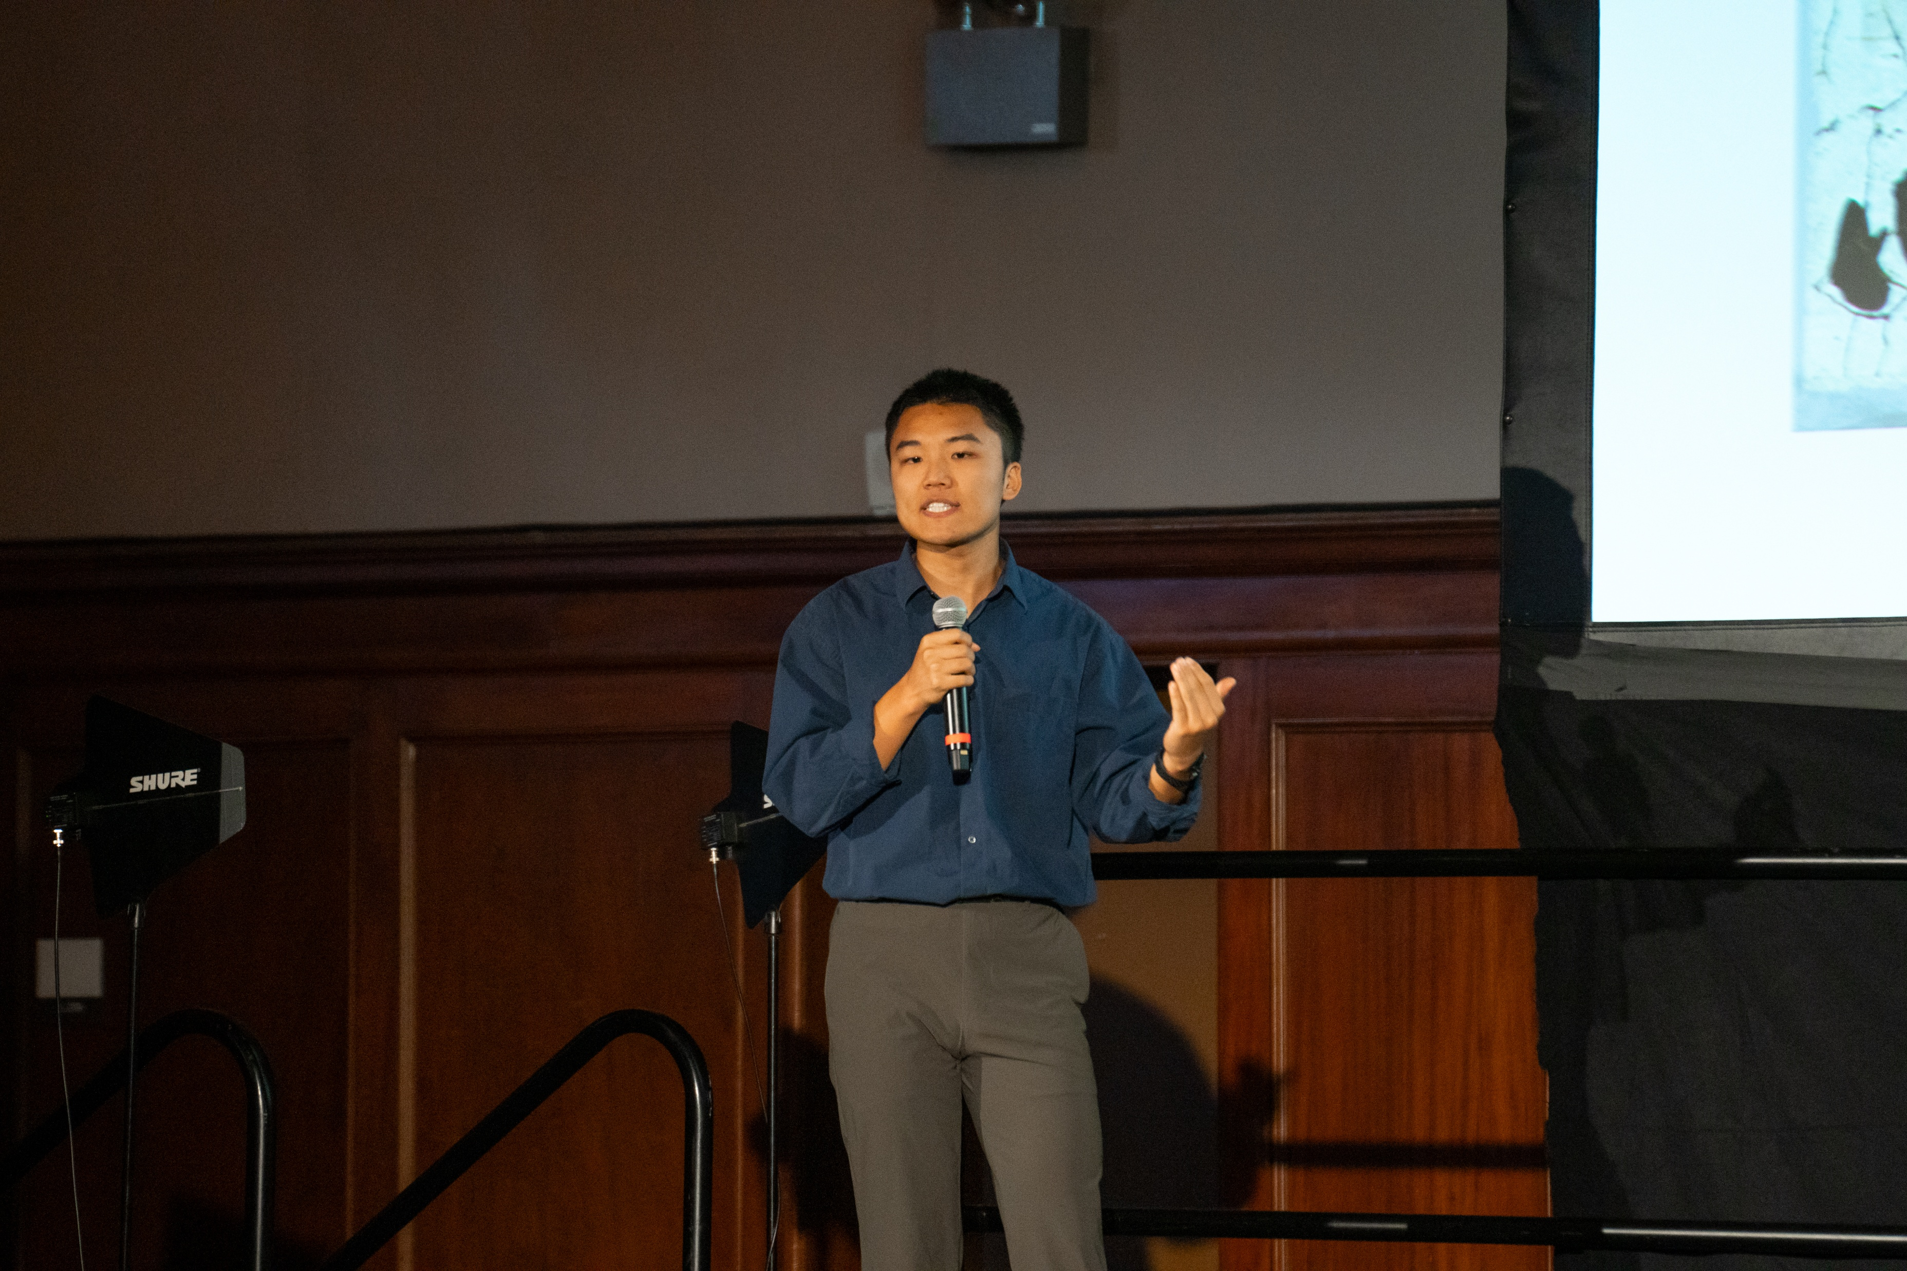

WHO CAN APPLY?
Any UT Austin graduate student!
Choose teams that have:
At least 2 students
At least one community partner
Bonus points: combine expertise from arts, humanities and mental health

Slide 4
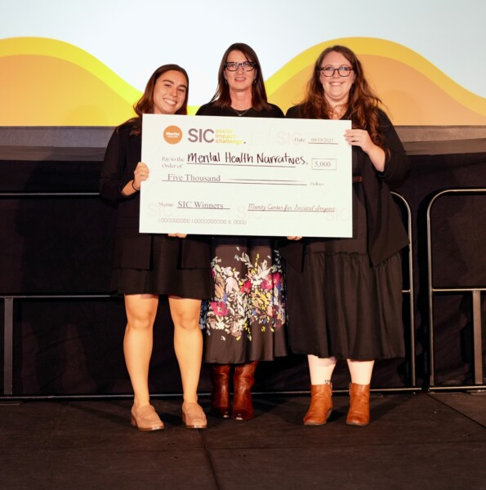
WHAT DO I WIN?
Prize: Top two projects get $5,000 each for 2026-2027 academic year
Recognition: UT Austin and local media
Project support: Moritz team is available to answer all questions, such as financial, regulatory, etc.
Connections: collaboration with local arts organizations, mental health clinics, and other relevant stakeholders

Slide 5
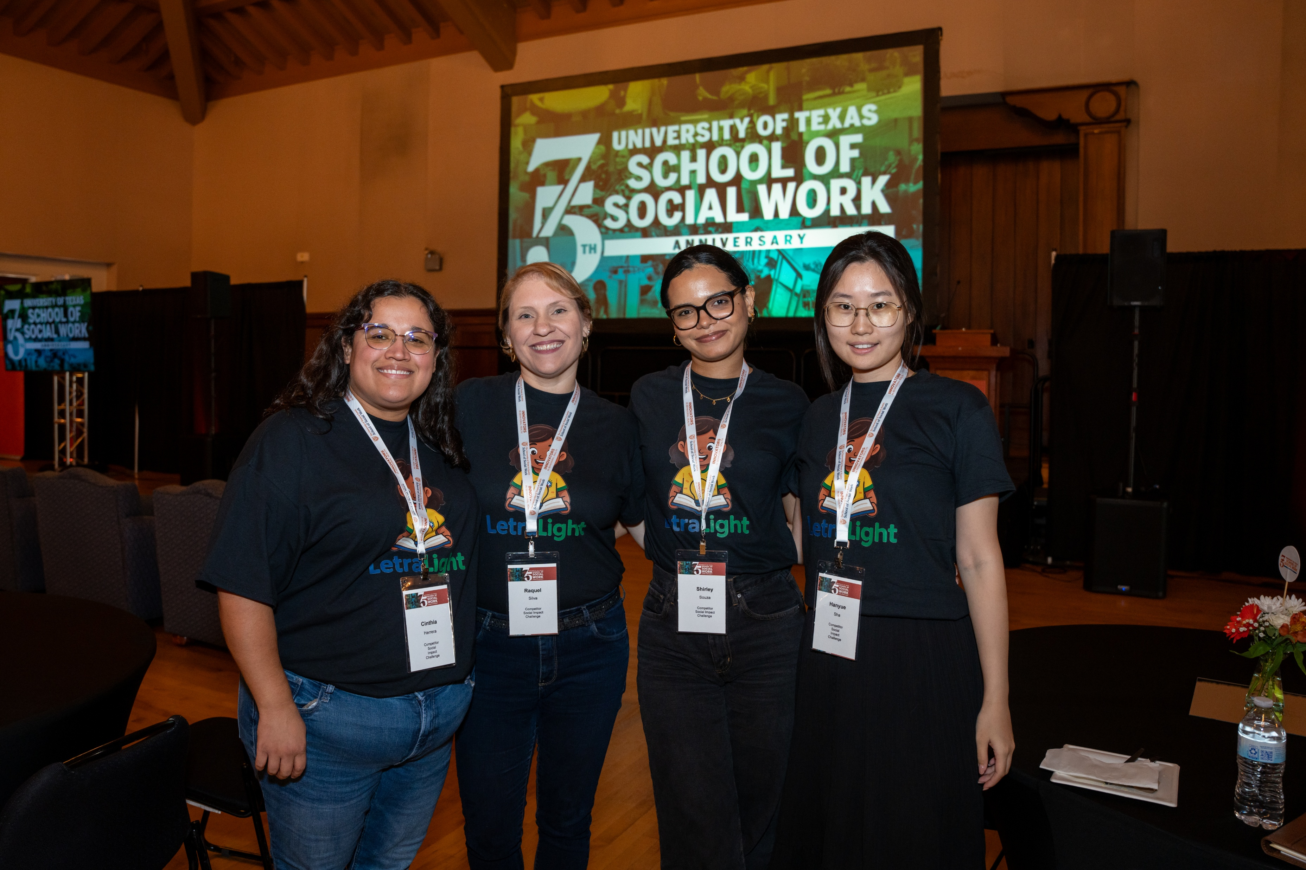
WHY ARE WE DOING THIS?
Objective: To challenge students and faculty to develop creative, innovative projects using arts and humanities to address behavioral health needs in the UT Austin and Austin area communities.
Goal: To promote mental health awareness, reduce stigma, and develop sustainable projects that improve well-being through artistic and humanistic approaches.

Slide 6
Timeline Overview
Applications opened | April 15
Applications close | June 30
Notification of advancement (five teams advance) | July 20
“Boot camp” with mentor | 4 sessions in Aug/Sep (may be virtual)
Final meeting with mentor | ~September 8
PITCH DAY: two teams chosen | Tuesday, September 15
Project completion | September 2026 – April 2027

Slide 7
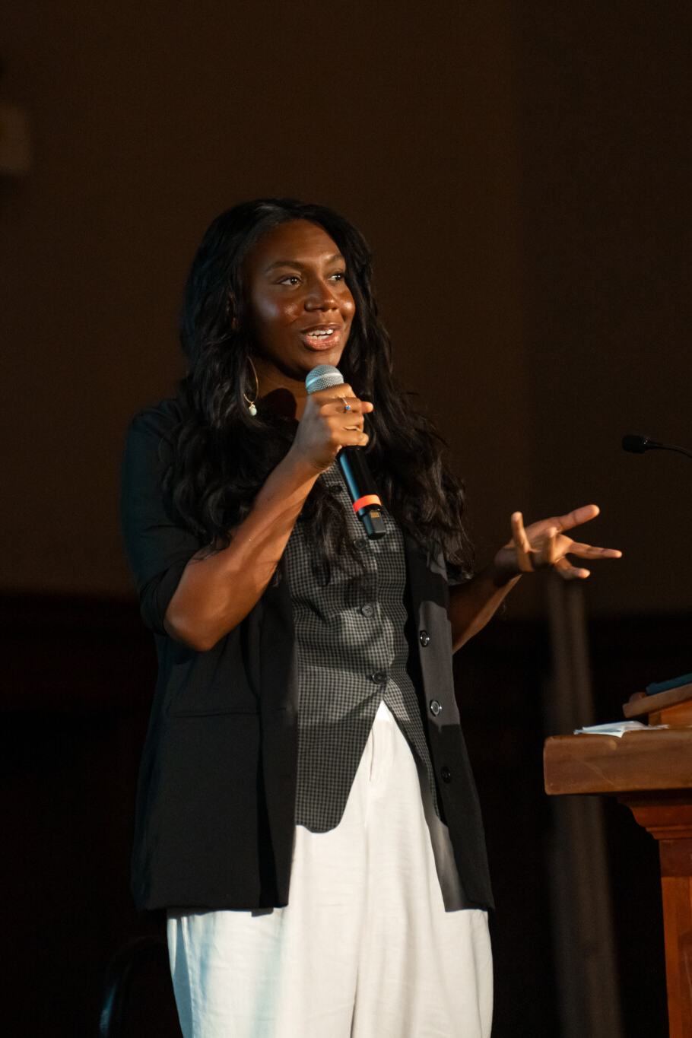
HOW DO I WIN?
Potential Focus Areas for Proposals:
Creative Arts Therapy
Educational Projects
Digital Arts
Selection Criteria:
Innovation and creativity
Impact potential
Feasibility and sustainability
Community Engagement
Narrative and Storytelling
Clear connection between behavioral health issues and arts/humanities
Partnership(s)

Slide 8
WHAT ARE PROCESS REQUIREMENTS?
Qualtrics application
Project overview (500 words)
Goals and impact (500 words)
Timeline and feasibility
Team members and their roles (2-5 students and a community partner)
Budget and resource needs
Innovative approach to behavioral health (why the arts/humanities can provide a solution)
Boot camp
Attend pitch competition

Slide 9
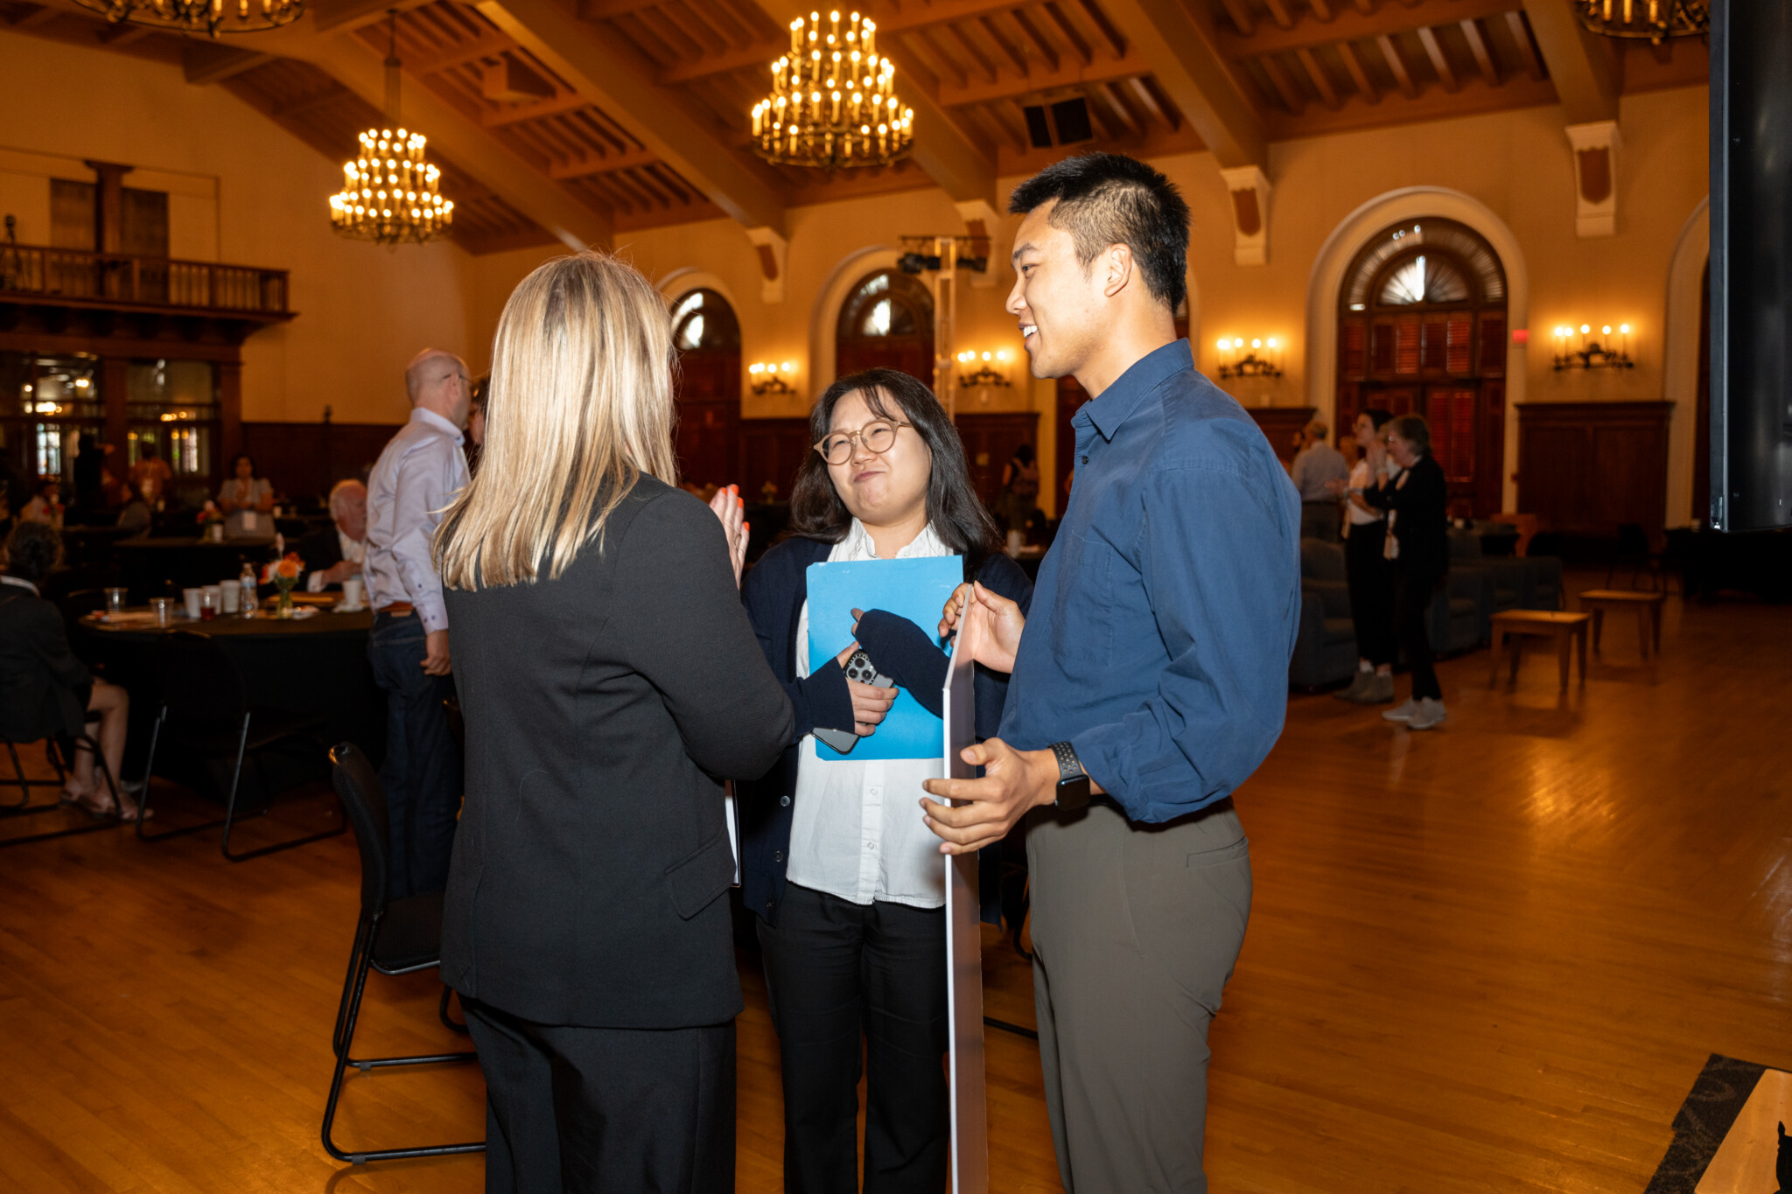
WHAT HAPPENS AT BOOT CAMPS?
5 chosen teams will attend summer boot camp
Your team will be assigned a faculty member or non-profit behavioral health mentor from the arts, humanities, and mental health fields for guidance and feedback leading up to the competitions
Meet a minimum of 4-5 times in August/September 2026
Refine your pitch according to the selection criteria
Practice your pitch!
Final meeting ~September 8, 2026
** There will be a rehearsal in early September

Slide 10
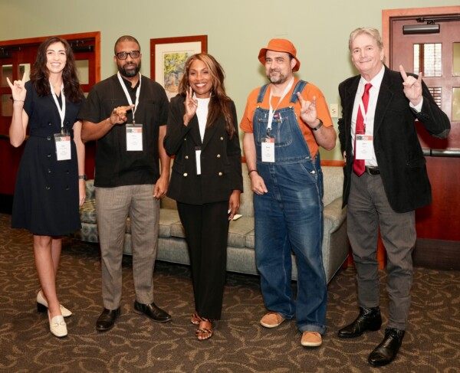
WHAT HAPPENS AT THE COMPETITION?
Each team gives 5-minute pitch at the event
5-minute Q&A session with judges follows each pitch
Note: Judges will receive your slide deck one week in advance to pre-review each project
Judging panel:
Faculty from the arts and humanities
Behavioral health professionals
Reps from local arts or behavioral health organizations
Community members
Mental health advocates

Slide 11
IF I WIN…WHAT HAPPENS NEXT?
October-April: Meet monthly with Moritz SIC team to touch base on progress made or troubleshoot
January: Provide a short mid-project report on progress
April: Provide a short final project report
May: Present your accomplishments at a Moritz Center-sponsored event to showcase your success

Slide 12
WHEN WILL I HEAR IF I WON?
NO DELAY OF GRATIFICATION!!
YOU WILL FIND OUT ON THE SPOT!

Slide 13
QUESTIONS?
Lauren Bell, 2025 SIC awardee, is here to answer your questions

